Slide 1
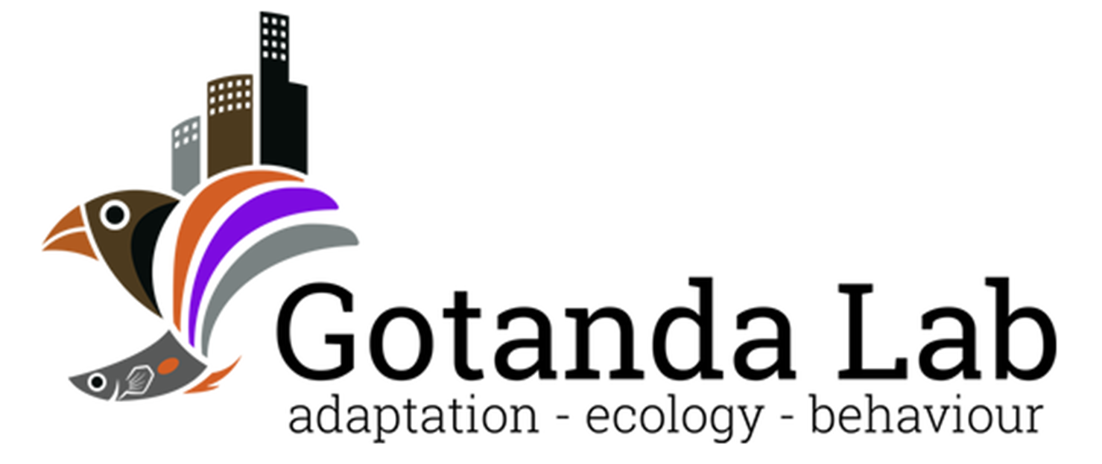

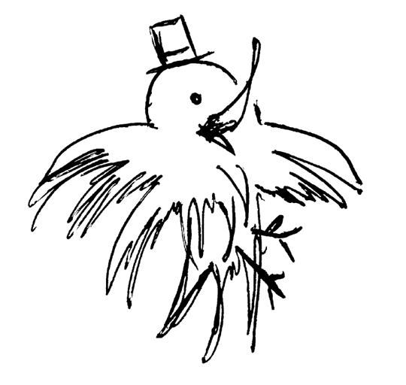
Heads Up!
Social Vigilance Behavior in American Crows
Alex Popescu, Dr. Kiyoko M. Gotanda
ABS 2024
Brock University

Slide 2
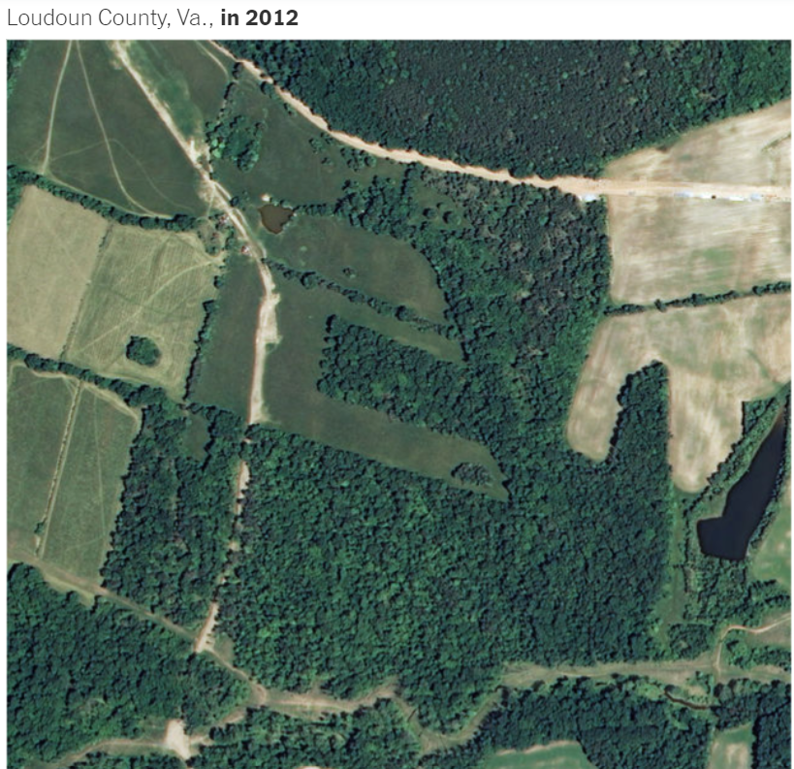
Urbanization
The shift in human population from rural to urban areas
NY Times, 2019
Notes:
~55% of world population currently concentrated in urban areas, with the UN projecting that number to climb to 68% by 2050.
Get a better image or polish it up

Slide 3
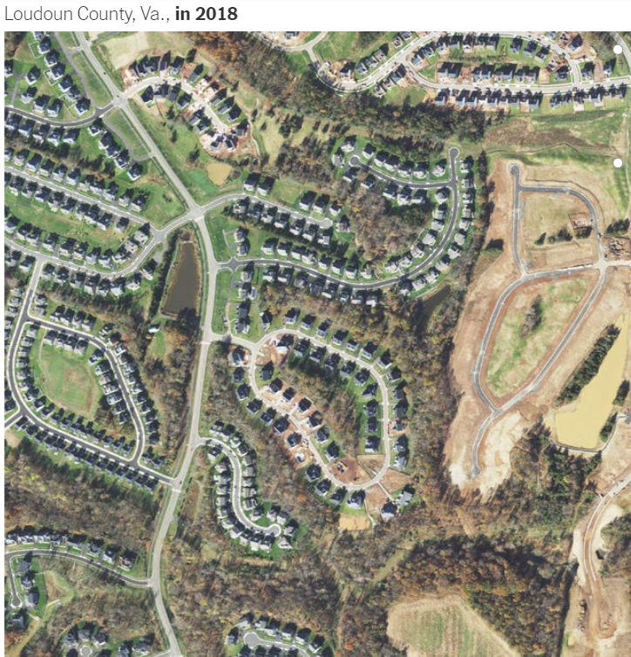
Urbanization
Leads to changes in the environment:
↓ Lines of sight
↑ Human-animal interactions
↓ Green spaces
NY Times, 2019
Notes:
~55% of world population currently concentrated in urban areas, with the UN projecting that number to climb to 68% by 2050.
Get a better image or polish it up

Slide 4
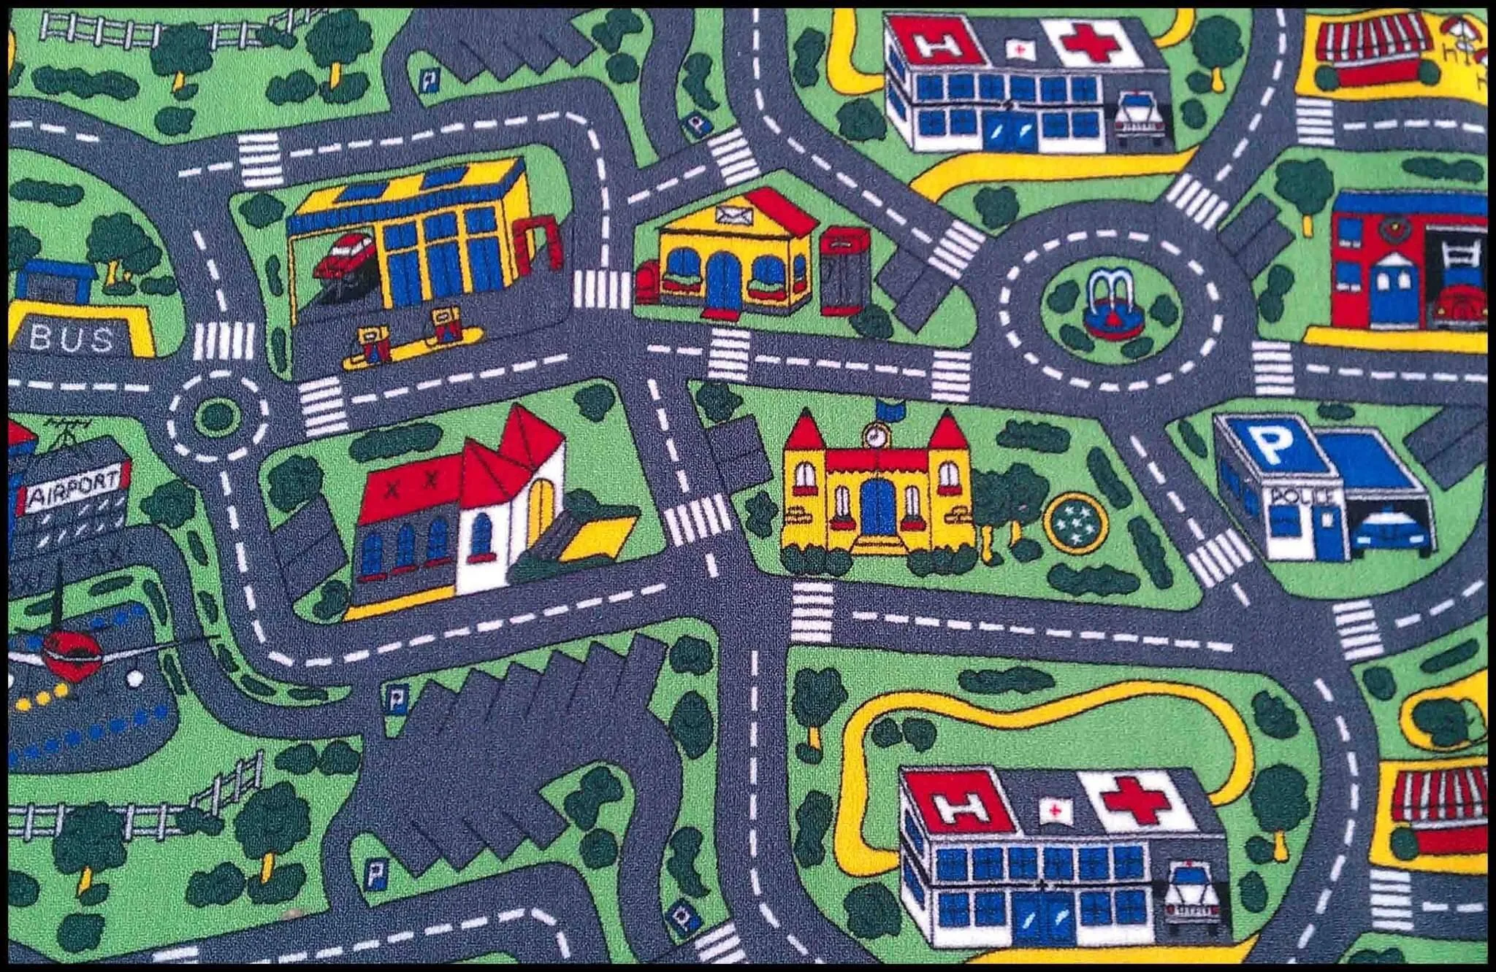
Urbanization
Urban areas are not uniform!
Has negative effects on many species; associated with the global loss of biodiversity
Kowarik I. 2011
Notes:
Better resolution image, remove url and add photo author.
You can probably remove the title in the reference

Slide 5
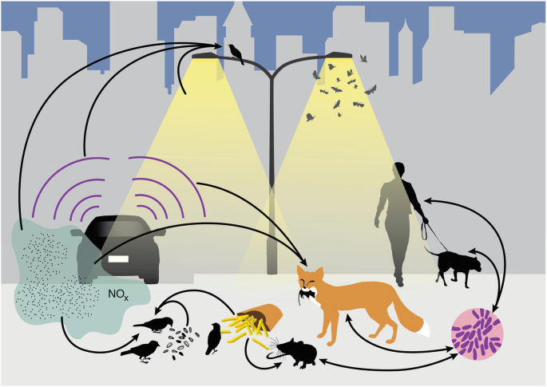
Can species be successful in cities?
Will depend on species’ traits
Advantageous traits:
Adaptability
A generalist nature
An omnivorous diet
Intelligence
Isaksson, C. (2018)
Patankar S et al. 2021
Notes:
Modified diet
↑ Interspecific aggression
↑ Tolerance of risks
↑ Tolerance of human proximity

Slide 6
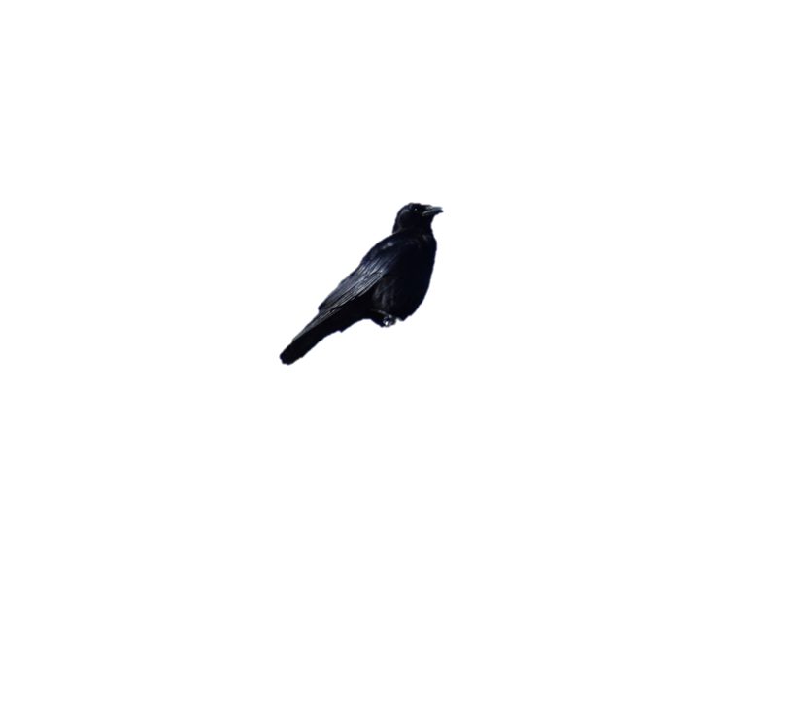
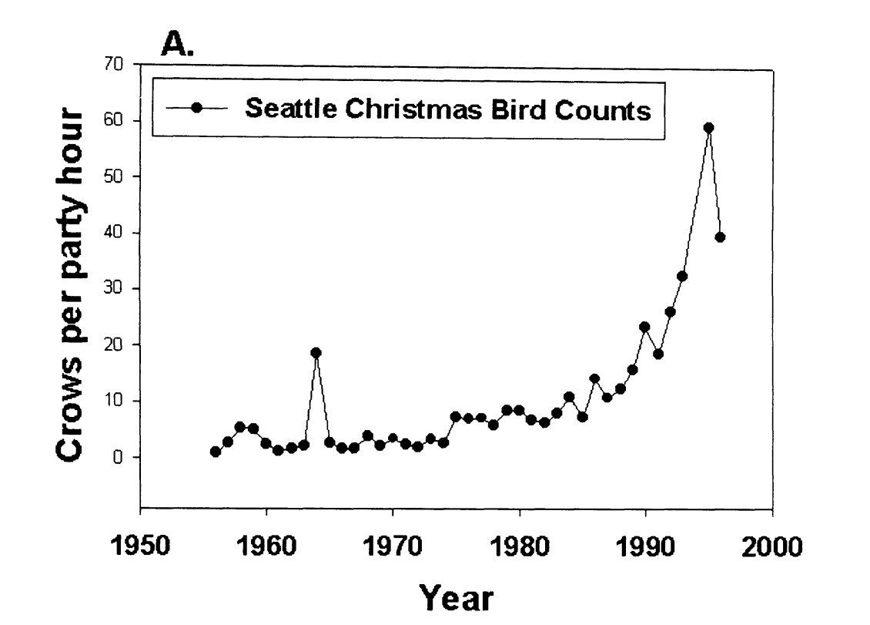
American crows in urban areas
Why are American crows so successful in urban areas?
Crows spotted per hour
American crow population increasing in urban areas over the last 5 decades
Marzluff et al.(2001)
Notes:
We picked the crow bc… Talk about G. env
Add caption for the image, remove the full citation

Slide 7
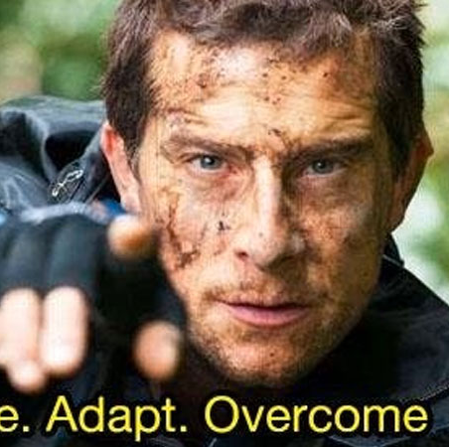
Behavioural Adaptations
Species can alter their behaviours to better take advantage of urban resources.
Examples include changes in vigilance and foraging behaviours

Slide 8
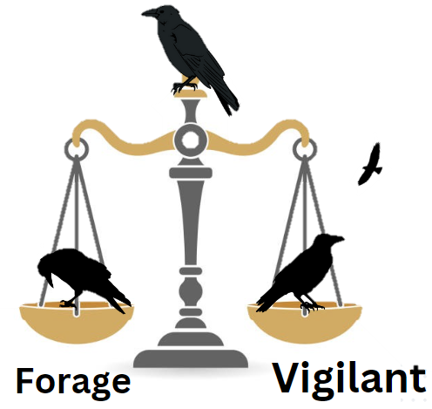
Vigilance and social foraging behaviour
A trade-off between vigilance and foraging efficiency
A balancing act between the need to eat, and the need to not be eaten.
Notes:
Prediction:
Hold your audience’s hand for the predictions. Be explicit!
Introduce the scale
Re-do the image

Slide 9
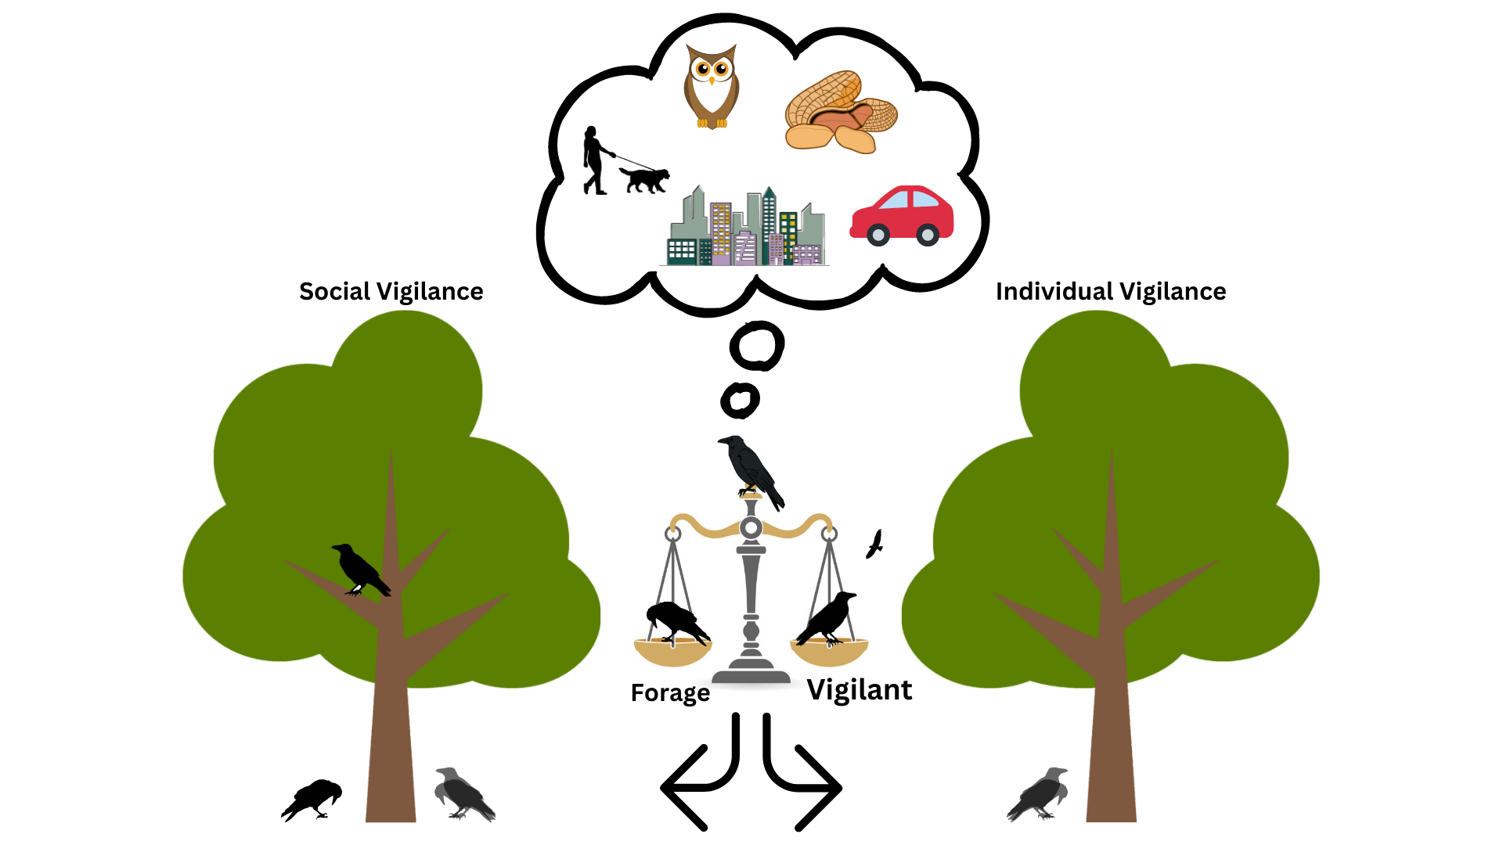

Sentinels
The vigilance of the sentinel provides protection to foraging group-members.
Social Foraging
Individual Foraging
Notes:
Shorten! Remove too much info about sentinels & focus on urbanization/G. Env

Slide 10
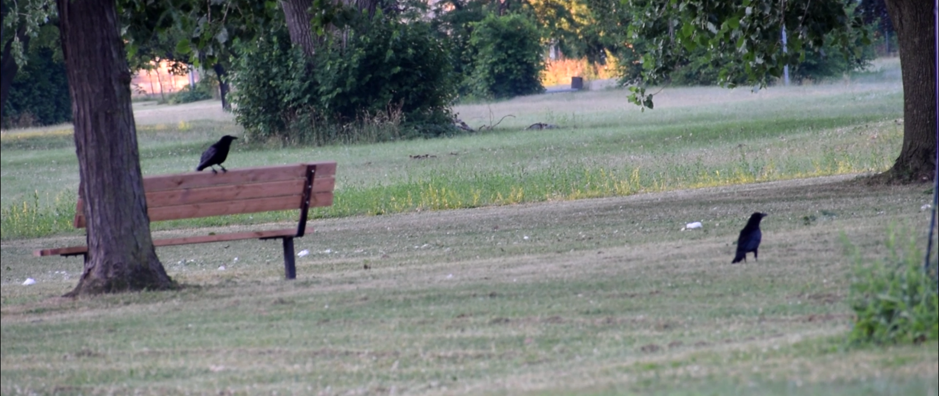
Sentinels
Notes:
Remove prediction about sentinels, just show what sentinels look like.
Consider putting the video in.

Slide 11
My objective
Determine if an individual’s foraging vigilance is affected by the presence of a sentinel and the environment in which it forages in.
The modified use of social behaviors is understudied.
Could explain, in part, the success of American crows in urban areas.
Notes:
Update this and add B-WW-SB. Be explicit!
Add image behind this slide

Slide 12
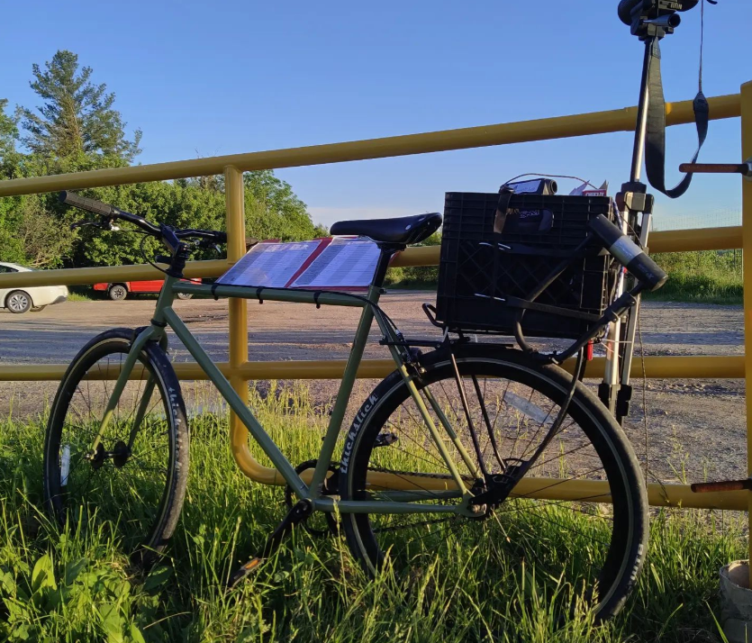
Methods
Testing sites were selected through a community science initiative: Crowkémon Go
Notes:
Explain verbally WHY you baited the sites.

Slide 13
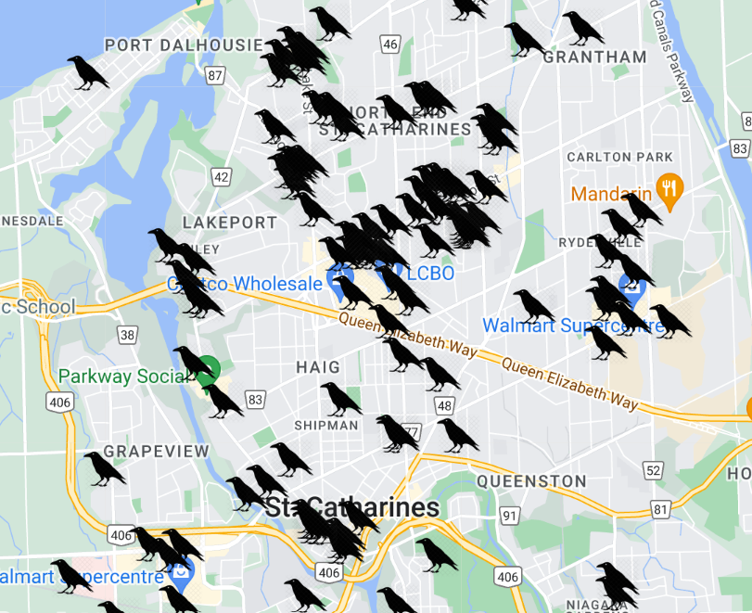
Crowkemon Go
Started in Jan 2022
Participants across the Niagara region were invited to mark the locations of crows.
Notes:
Be concise!
Make clear that all sites are in

Slide 14
Methods
Testing sites were selected through a community science initiative: Crowkémon Go
Foraging bouts were video recorded from a distance and analyzed at a later date
Notes:
Armed with friends, cameras and bicycles, we bravely went out at 6am to chase crows!
Remove bait
Add images to explain generalized environment.

Slide 15
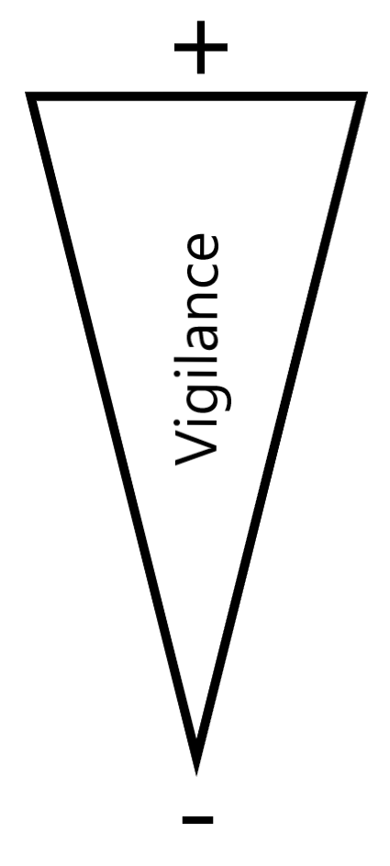


Methods
Alert
Moving
Foraging
Notes:
Can’t tell what the crow is looking at when moving (verbal)

Slide 16
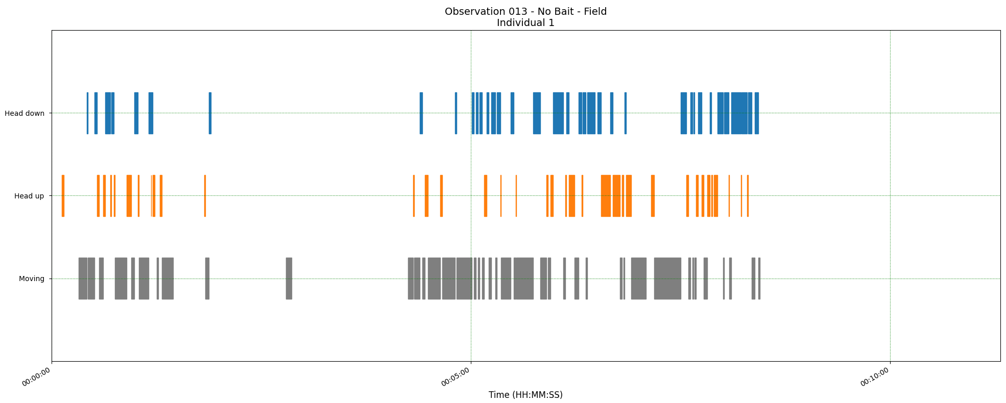
Methods
Three measurements:
The proportion of ‘foraging time’ allocated to each behavior
Duration of behavioral instances
Foraging
Alert
Moving
Time
Notes:
***Briefly explain & put arrows to show what each measurement is ***
**DO NOT MENTION BORIS!!!**
Explain the measurements explicitly.

Slide 17
Research questions
 | Generalized Environment | Sentinel Presence
Allocation of time to behaviors in foragers | In green areas Foraging ↑ Alert ↓ | With a sentinel present Foraging ↑ Alert ↓
Duration of behavioral instances | In green areas Foraging ↑ Alert ↓ | With a sentinel present Foraging ↑ Alert ↓
Notes:
Remove right side, focus only on G. Env.
Be quick about it, no need to repeat, consider having the table reappear between results slides.

Slide 18
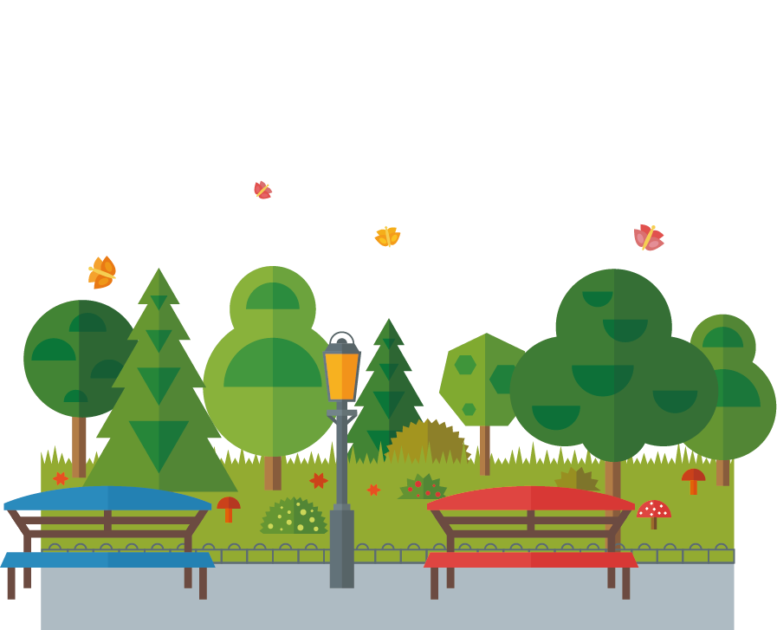

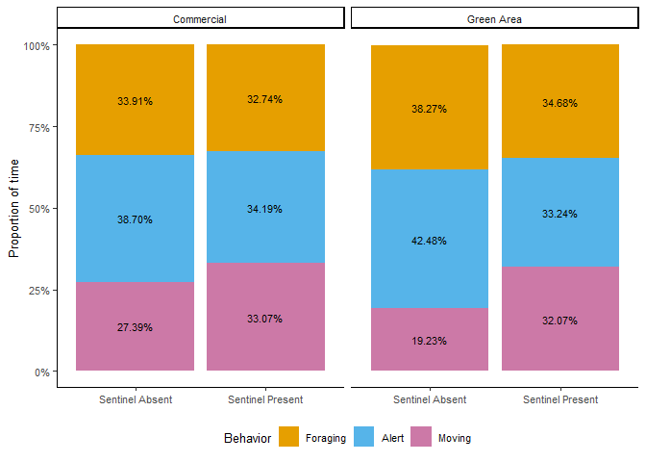

Proportion of time
Contrary to my predictions, there were no significant effects!
Proportion of foraging time
Notes:
Remove gridlines! (Go back in R, theme_classic())
Add in-between slide with thesis questions, bring it up as you answer the questions.

Slide 19
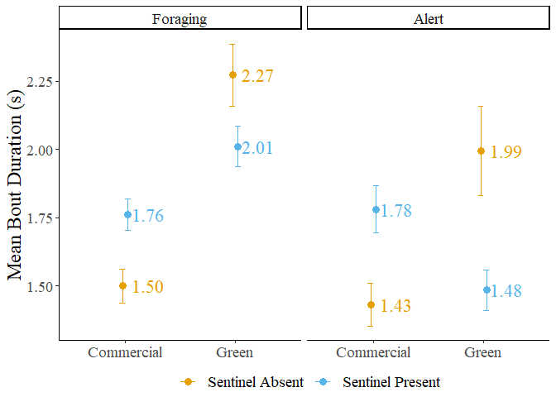
Behavioural Instance Duration
Sentinel presence did not significantly affect the duration of bouts.
Bouts of foraging behaviour were significantly longer in green areas.
No significant effects on bouts of alert behaviour.

Slide 20
Behavioural Instance Duration
Significant interaction between sentinel presence and generalized environment on both foraging and alert behaviours.

Slide 21
Generalized Environment
Food in green areas can take longer to forage on
Vegetation might obscure food – Time to find food ↑
Prey might use vegetation to escape – Time to catch food ↑
Comparatively, foraging in commercial areas could be easier
Impermeable surfaces ↑ – Time to find/catch food ↓
Anthropogenic resources ↑ – Time to find/catch food ↓

Slide 22
Generalized Environment
This could explain the shift in preference towards anthropogenic resources in urbanized species.
However, foraging on urban resources could be unhealthy
Caloric content ↑ but nutritional value ↓
Low quality but easily accessible
Higher quality resources in green areas – Worth the risk?

Slide 23

Sentinel Presence
Benefits from sentinel coverage could depend on foraging environment.
Foragers could also be foraging in a ‘riskier’ but more efficient manner in the presence of a sentinel.
More space between individuals – Risk ↑
Foraging over a wider area – Foraging Efficiency ↑

Slide 24
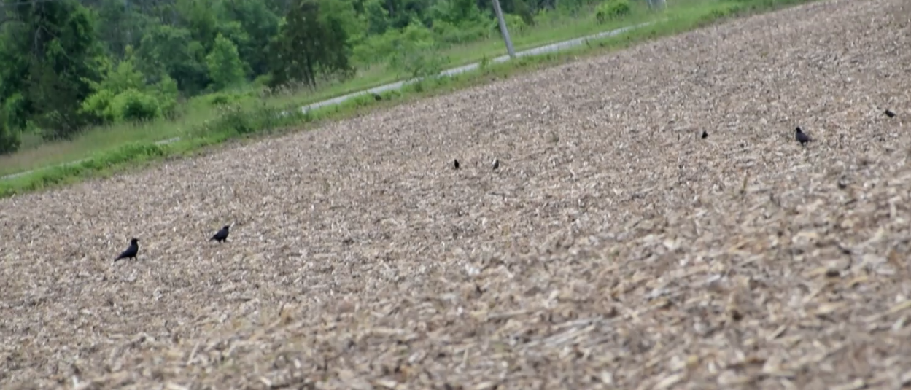
Some caveats
It is very difficult to tell what the crows are looking at when being alert:
Looking for threats and predators
Other species
Other crows
Did they find something?
Notes:
Add image to take up some of the white space before putting the big image up.
Not impossible

Slide 25
Research questions
 | Generalized Environment | Sentinel Presence
Allocation of time to behaviors in foragers | In green areas Foraging ↑ Alert ↓ | With a sentinel present Foraging ↑ Alert ↓
Duration of behavioral instances | In green areas Foraging ↑ Alert ↓ | With a sentinel present Foraging ↑ Alert ↓
No effect
No effect
In green areas
Foraging ↑
Significant interaction
Notes:
Remove right side, focus only on G. Env.
Be quick about it, no need to repeat, consider having the table reappear between results slides.

Slide 26
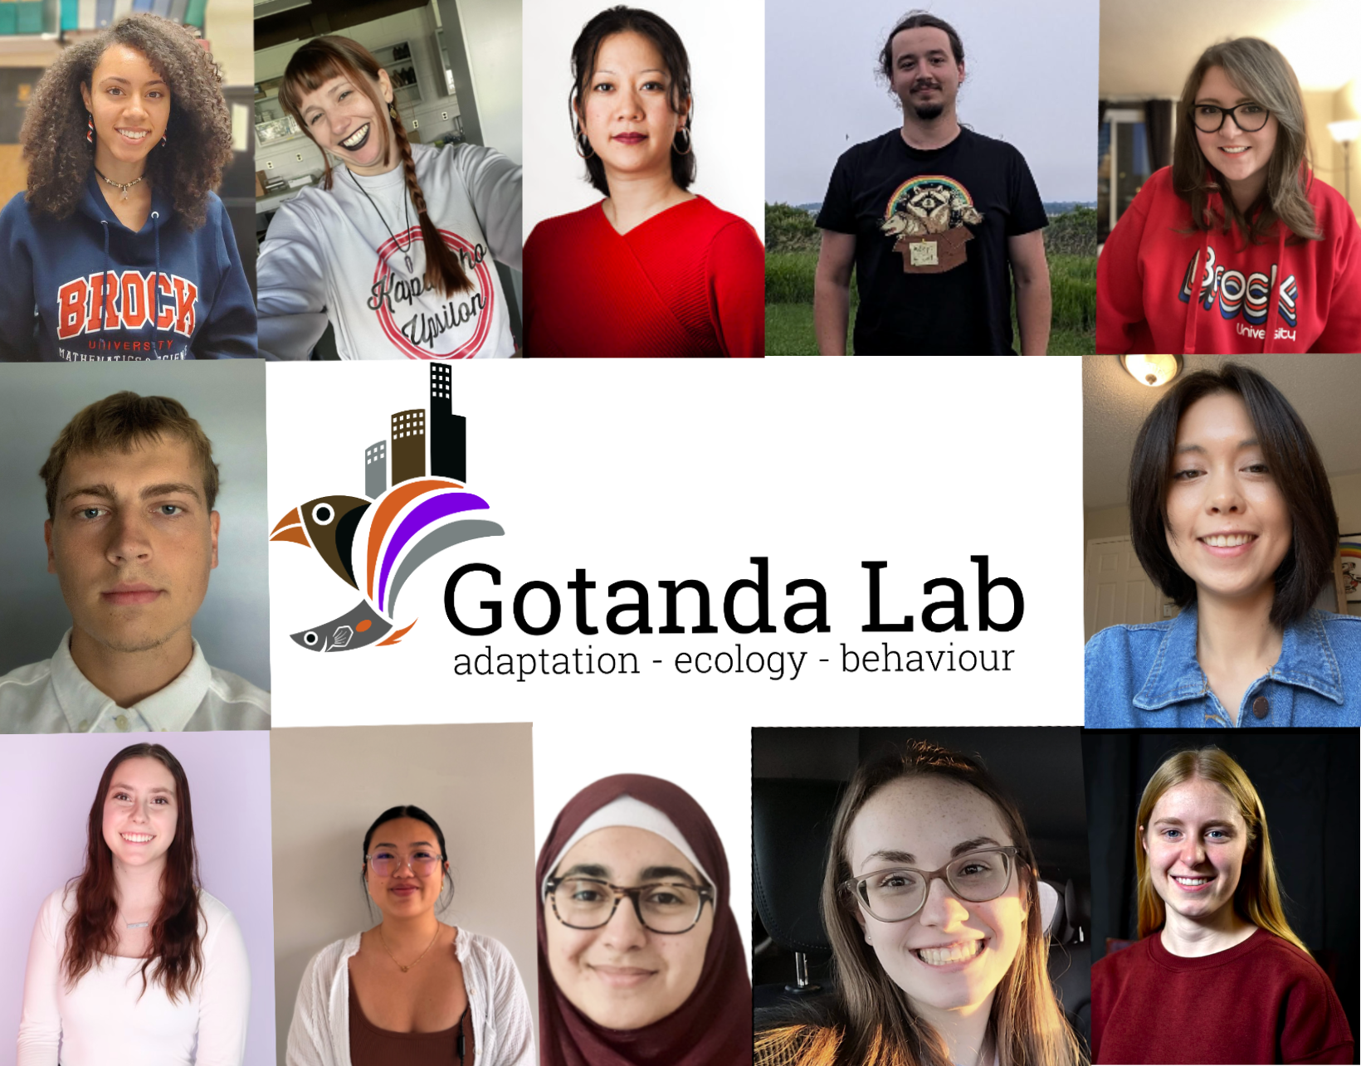
Acknowledgements
My supervisors: Dr. Kiyoko Gotanda, Dr. Liette Vasseur, Dr. Anne Clark
The Gotanda Lab
My family and friends
Notes:
Funded by Brock, no need to mention explicitly. Thank funding sources at a defense (which this isn’t)

Slide 27
Questions?

